Slide 1
Git - Basics
Git is a version control system for tracking changes in computer files and coordinating work on those files among multiple people.

Slide 2
Agenda
Advantages of git
Git life cycle
How to install git
How to create repository
How to clone repository
How to create a branch
How to raise a Pull request

Slide 3
Advantages of Git
Free and open source
Implicit backup
Security
No need of powerful hardware
Easier branching

Slide 4
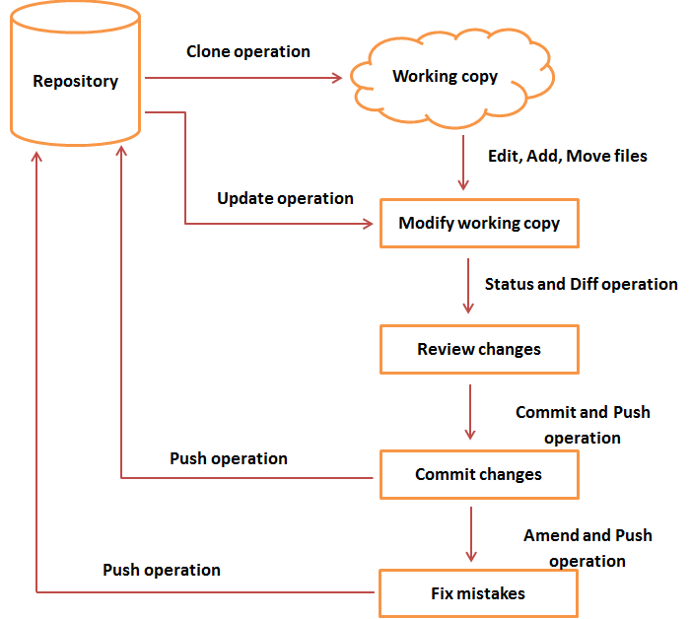
Git life cycle

Slide 5
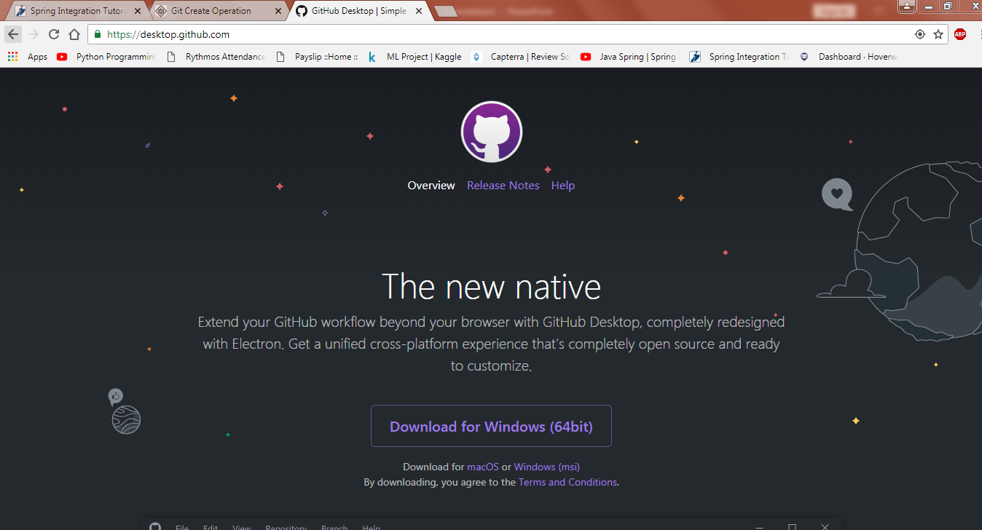
How to install GIT Desktop

Slide 6
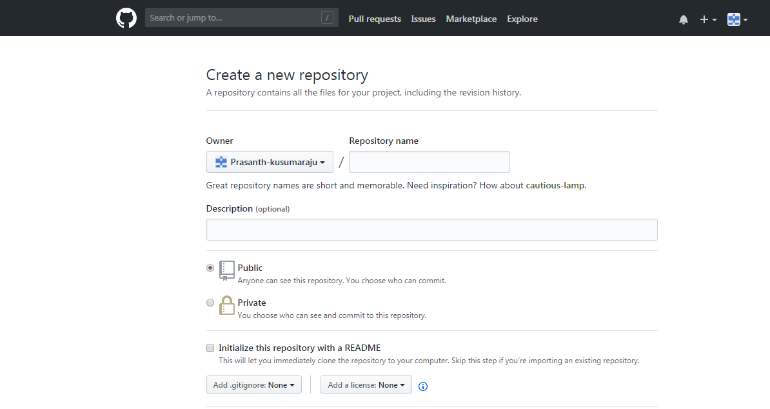
How to Create a Repository

Slide 7
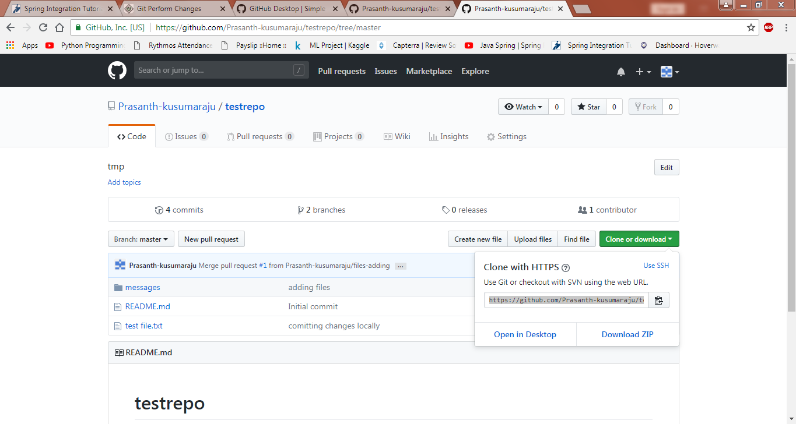
How to clone a git Repository

Slide 8
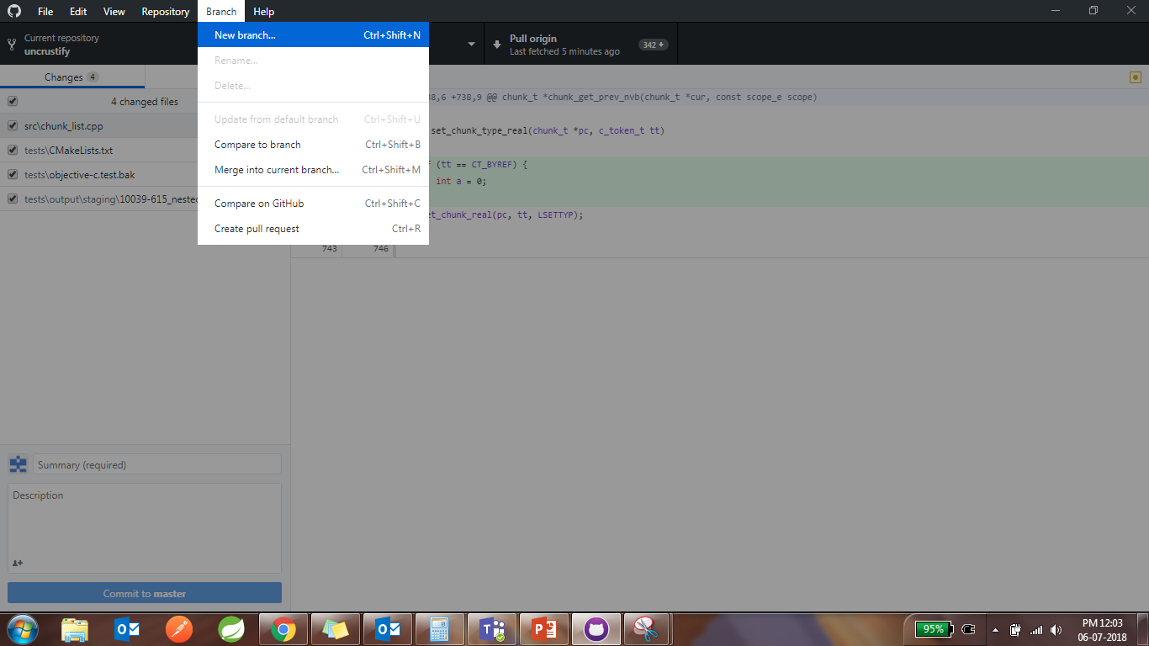
How to create a branch

Slide 9
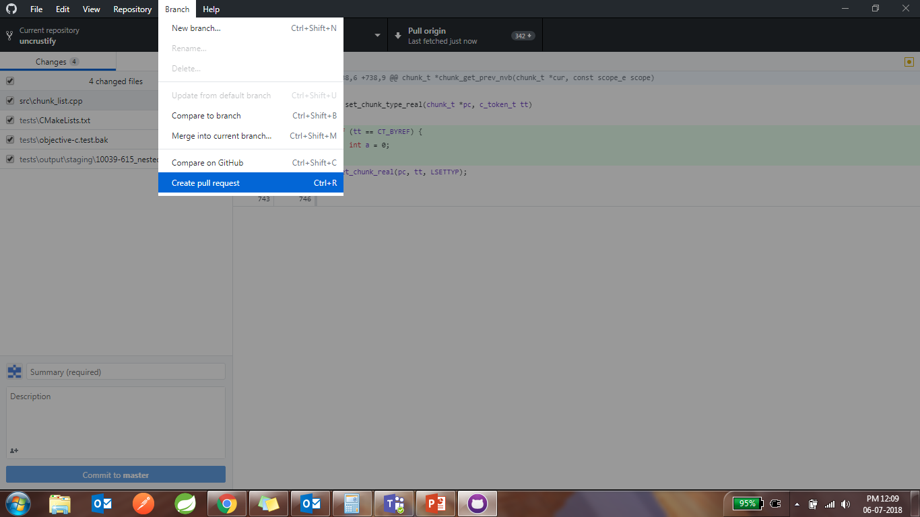
How to raise Pull Request

Slide 10
Thank you

